Slide 1
Adham Ashraf Saeed
Assignment 1

Slide 2

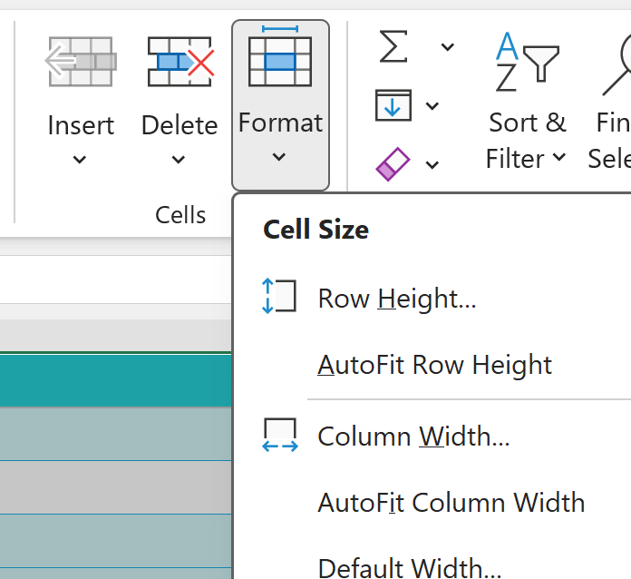
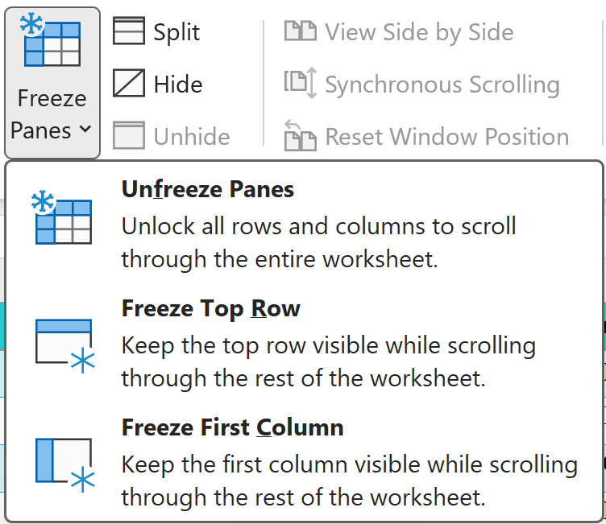
Task 1
Open the dataset file.
Rename the main sheet to Ecommerce_Data.
Freeze the header row.
Adjust column widths and row heights for readability.

Slide 3
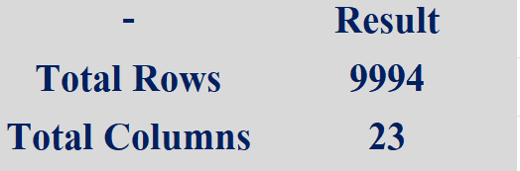

Task 2
Identify:
Total number of records (rows)
Total number of fields (columns)
Insert a new column called Total Sales Value.

Slide 4
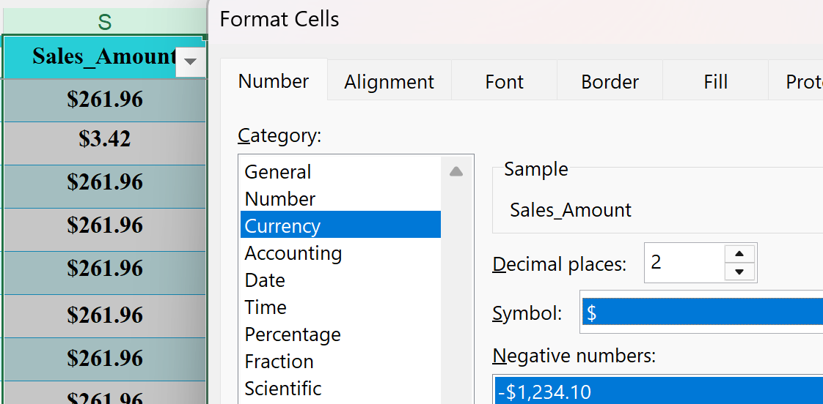
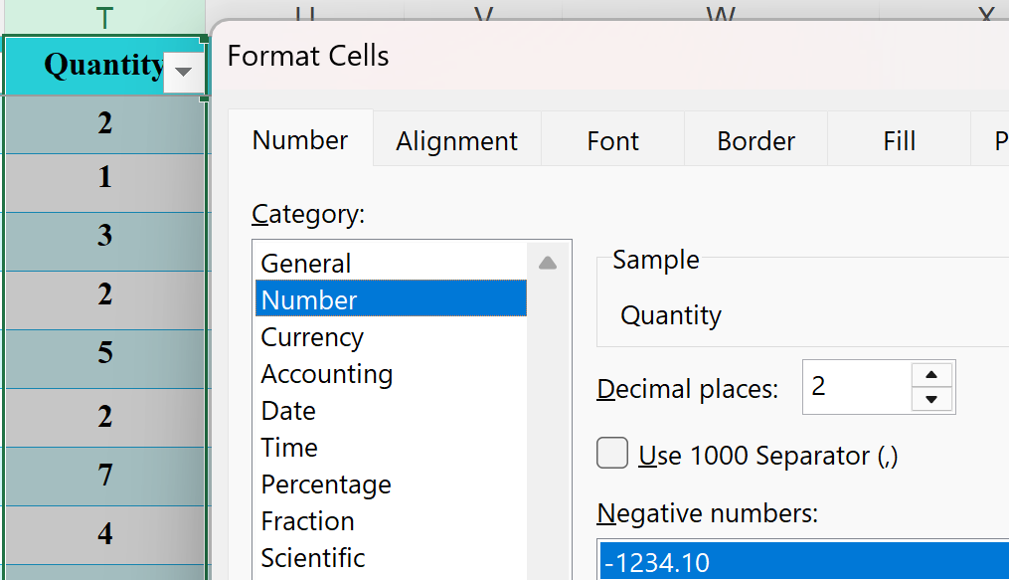
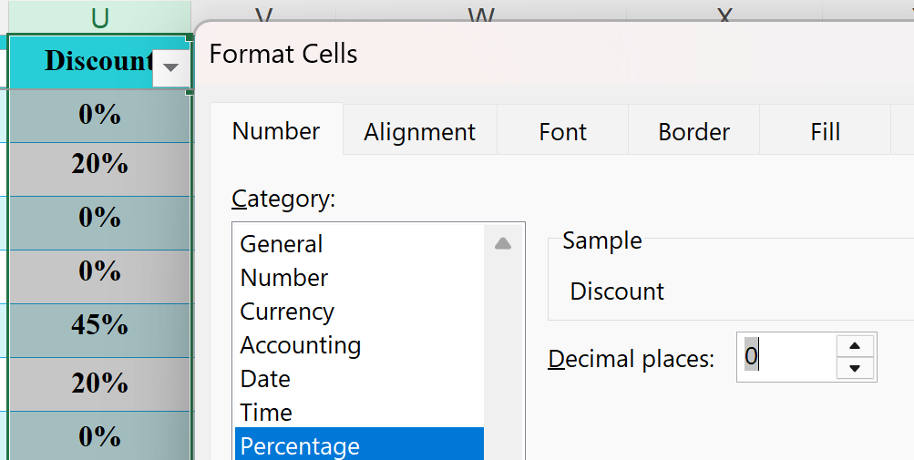
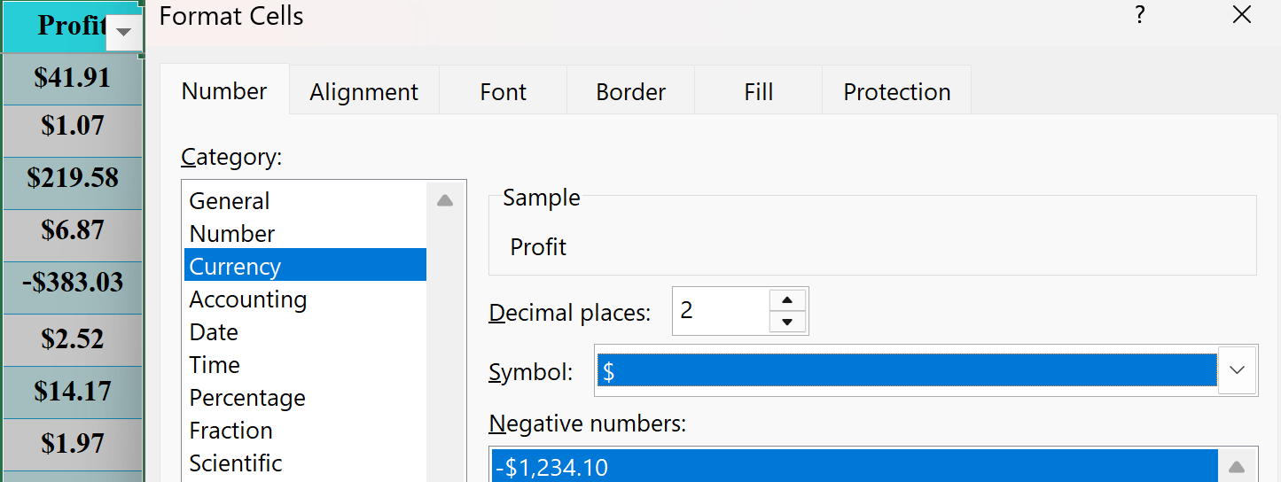
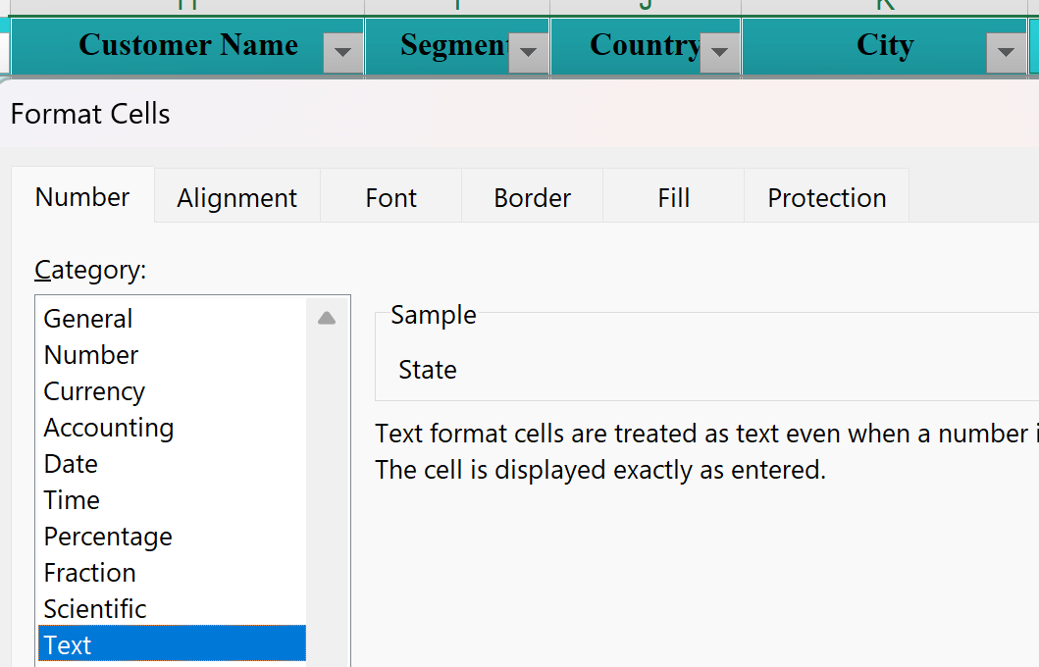
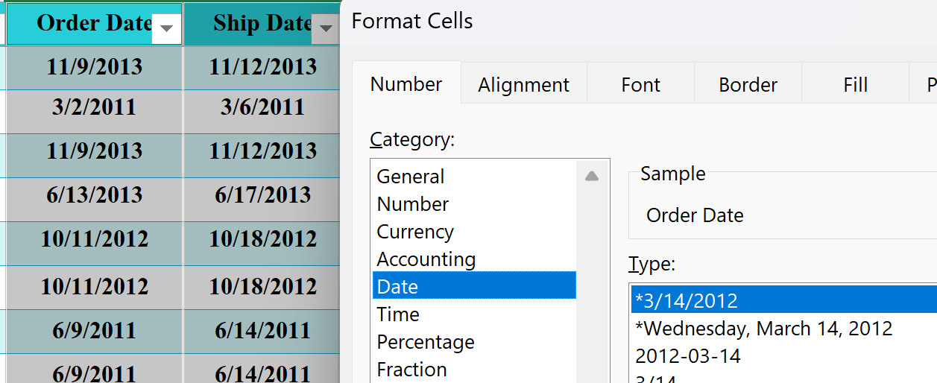
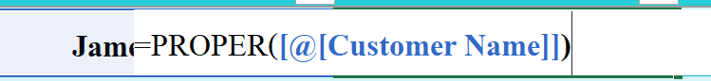
Task 3
Ensure:
Sales, Quantity, and Price columns are numeric.
Date columns are in proper date format.
Apply appropriate number formatting:
Currency for monetary values.
Standardize text formatting (Proper Case).

Slide 5
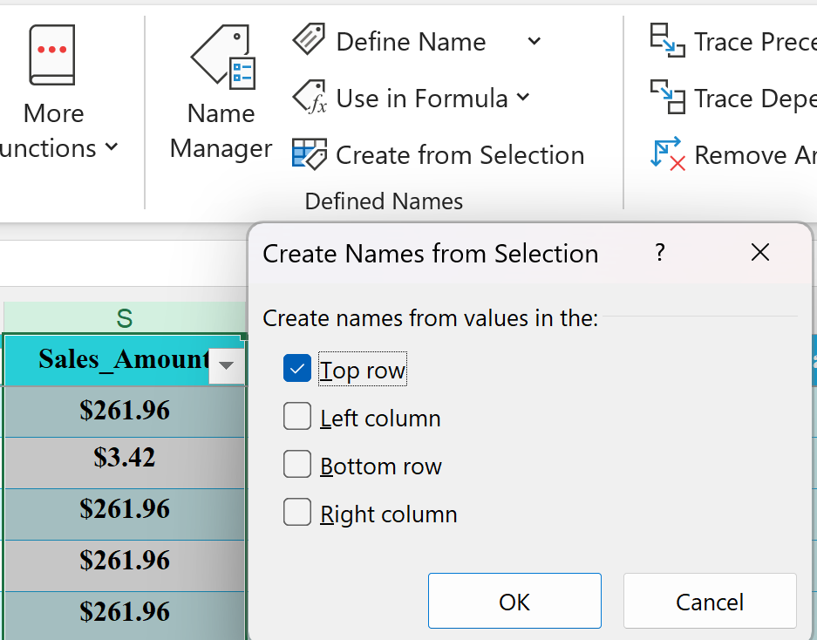


Task 4
Create a named range for:
Sales Amount column → Sales_Amount Use the named range in at least one formula.
Briefly explain why named ranges are useful.
Answer:
Named ranges make formulas easier to read and simplify worksheet management.

Slide 6
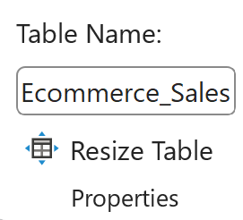
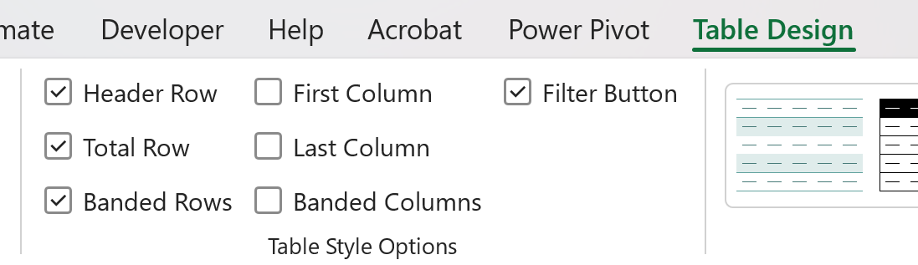
Task 5
Convert the entire dataset into an Excel Table.
Rename the table to Ecommerce_Sales.
Add a Total Row to the table.
Explain the advantage of using a table instead of a normal range.
Answer:
Tables provide easier sorting, filtering, and automatic expansion when new records are added.

Slide 7
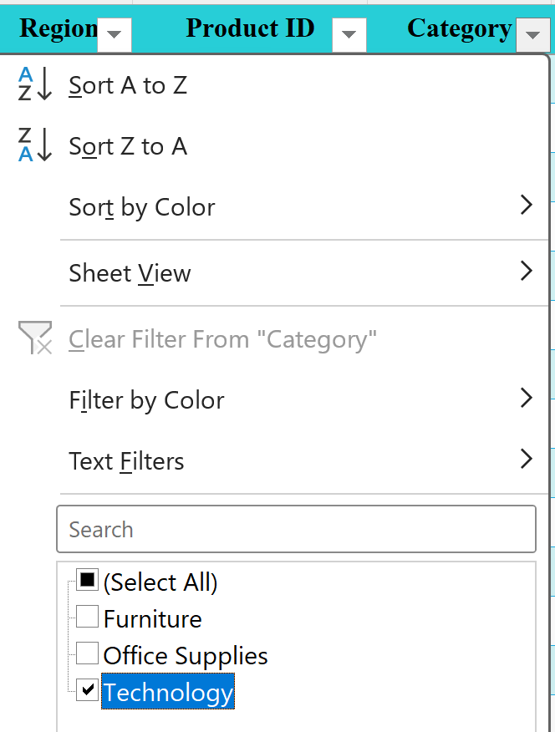
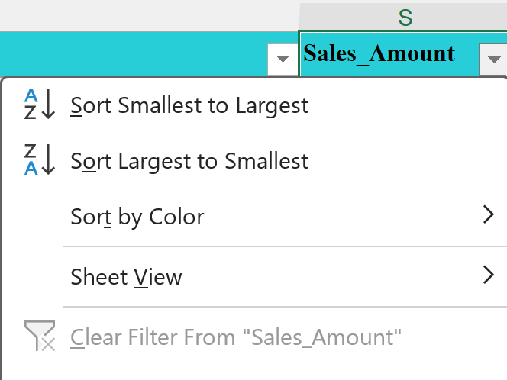
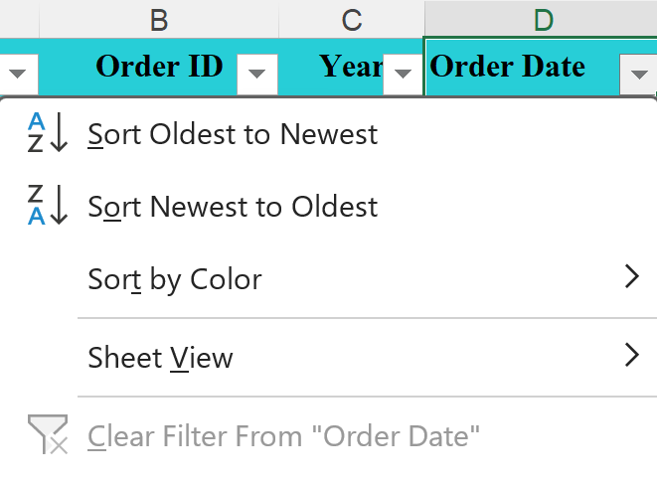
Task 6
Filter the table to show:
One selected product category.
Sort: Sales Amount (Highest → Lowest)
Order Date (Newest → Oldest)

Slide 8
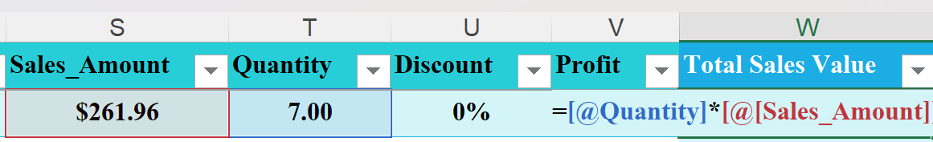
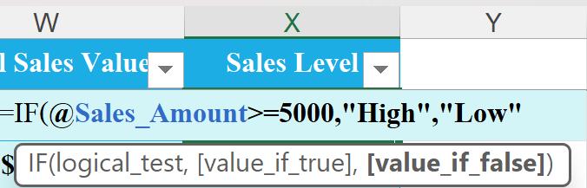
Task 7
Calculate Total Sales Value using:
Quantity × Unit Price
Create a new column Sales Level using:
IF Sales ≥ 5000 → "High"
Else → "Low"

Slide 9
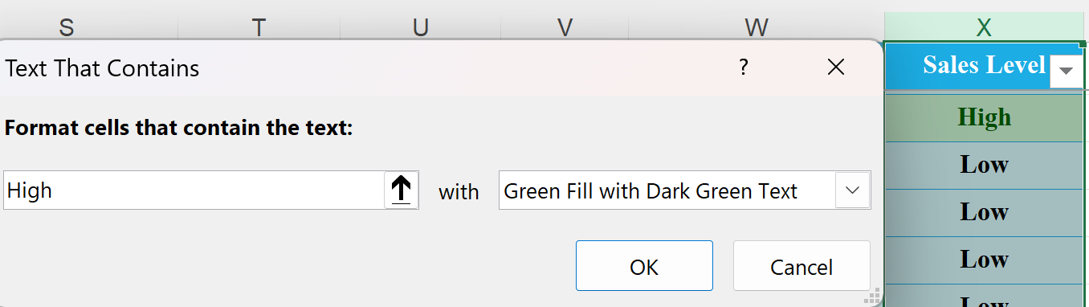
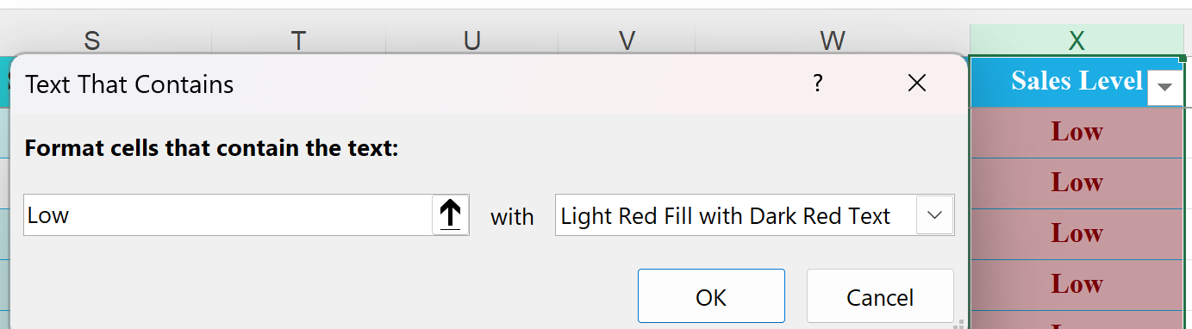
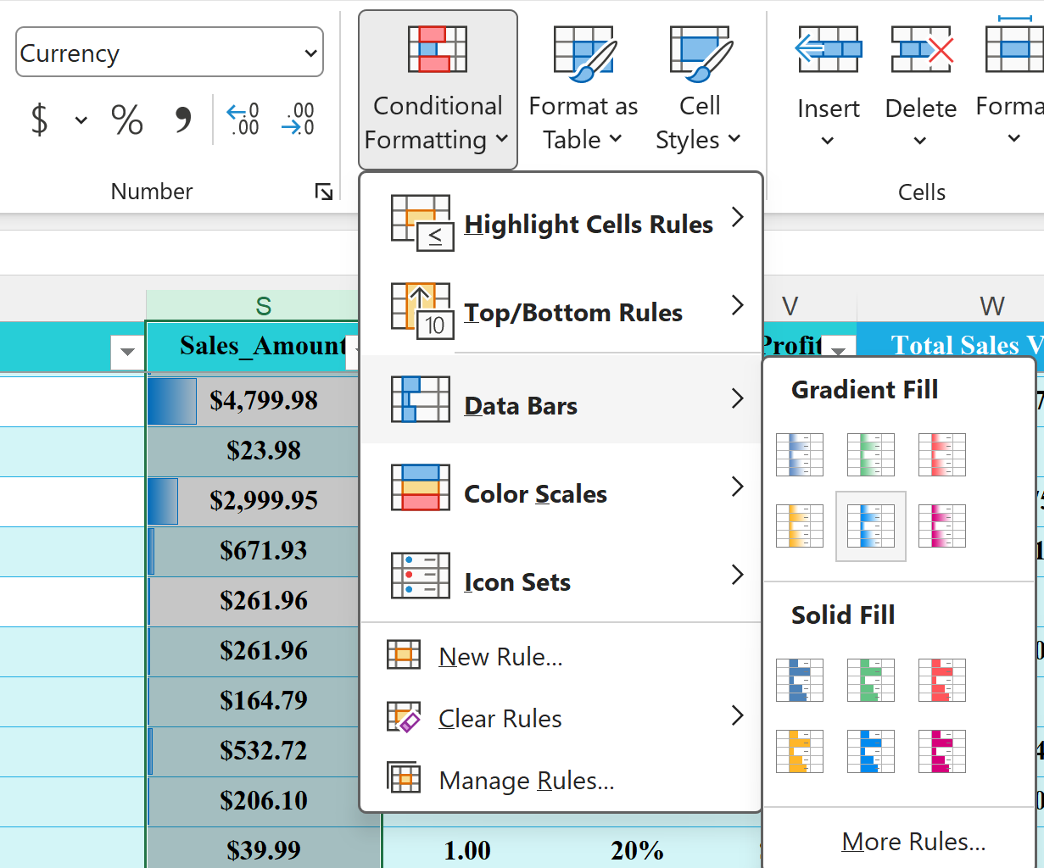
Task 8
Highlight:
High sales values in green.
Low sales values in red.
Apply Data Bars to the Sales column.

Slide 10
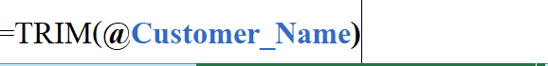
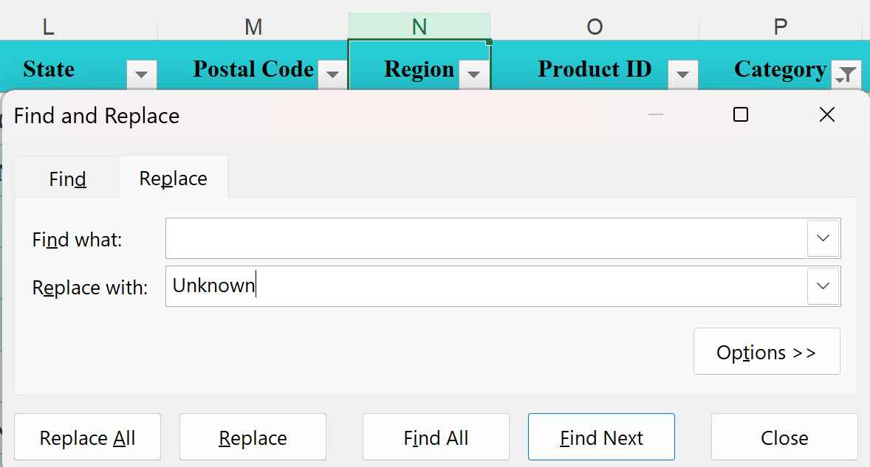
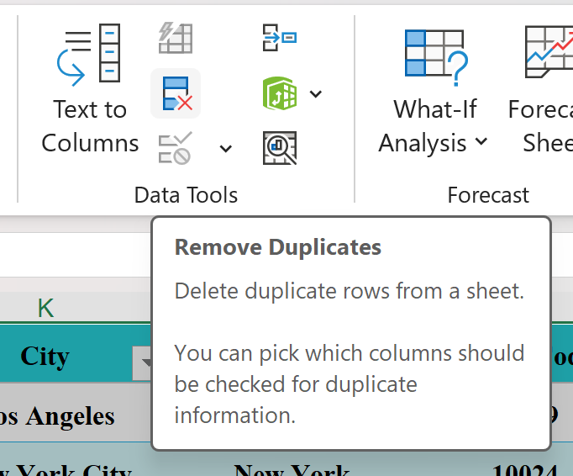
Task 9
Remove extra spaces from text fields.
Replace missing or blank values logically (e.g., Region → “Unknown”).
Remove duplicate records if found.

Slide 11
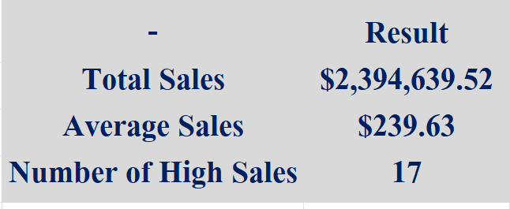
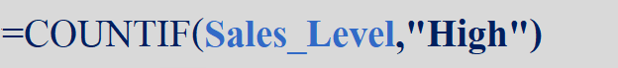
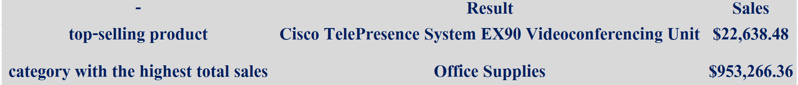
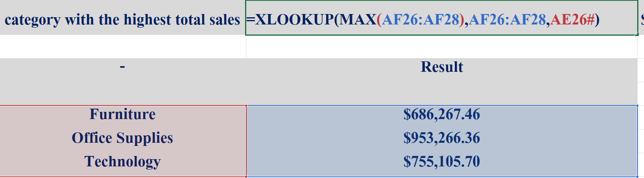
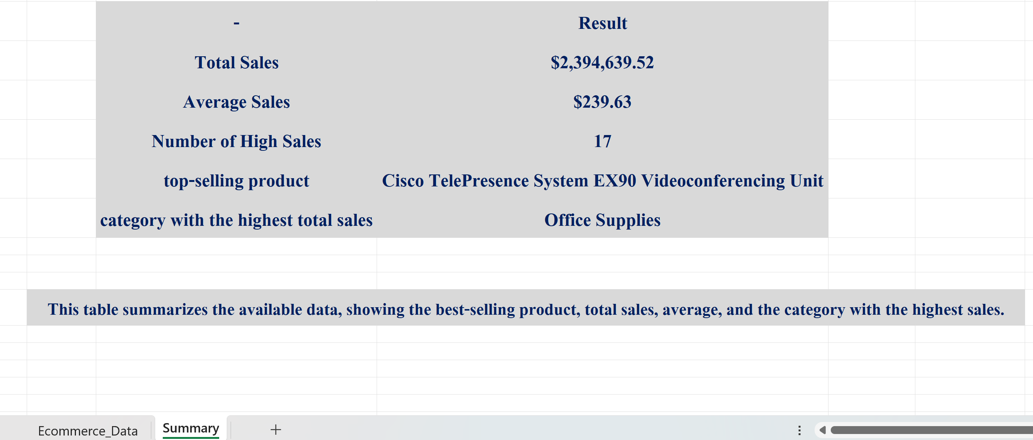
Task 10
Calculate:
Total Sales using SUM
Average Sales
Count: Number of High Sales using COUNTIF
Identify the top-selling product.
Identify the category with the highest total sales.
Add a short insight summary (2–3 sentences) in a new sheet.

